Slide 1

Python as a Language

Slide 2
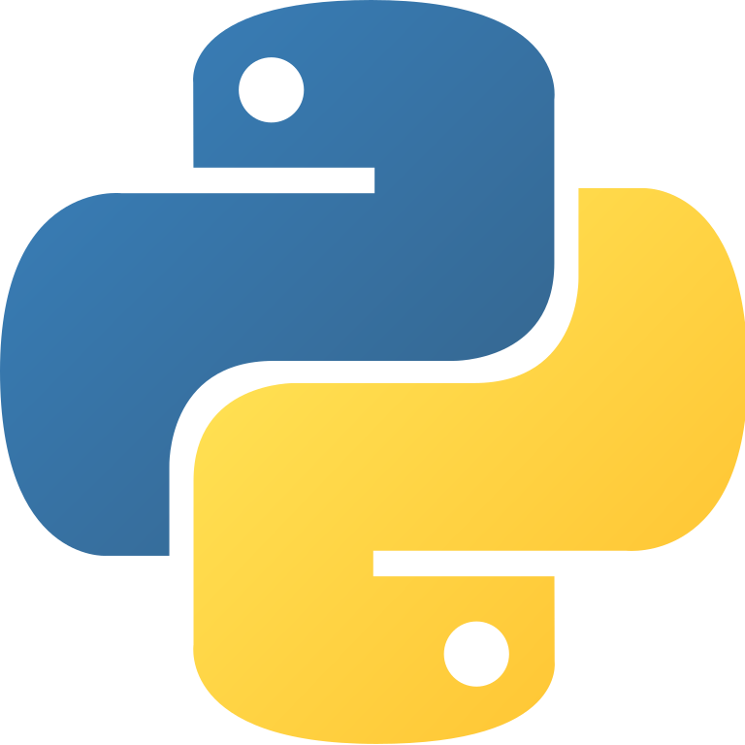
Python is a general-purpose interpreted, interactive, language. It was created by Guido van Rossum during 1985- object-oriented, and high-level programming 1990. Like Perl, Python source code is also available under the GNU General Public License (GPL).
Python is designed to be highly readable. It uses English keywords frequently where as other languages use punctuation, and it has fewer syntactical constructions than other languages.

Slide 3
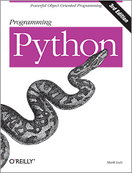

Python is the language of the Python Interpreter and those who can converse with it. An individual who can speak Python is known as a Pythonista. It is a very uncommon skill, and may be hereditary. Nearly all known Pythonistas use software initially developed by Guido van Rossum and released in 1991.

Slide 4
It is used for:
web development (server-side),
software development,
mathematics,
system scripting.

Slide 5
Why Python?
Python works on different platforms (Windows, Mac, Linux, Raspberry Pi, (etc.)
Python has a simple syntax similar to the English language.
Python has syntax that allows developers to write programs with fewer lines than some other programming languages.
Python runs on an interpreter system, meaning that code can be executed as soon as it is written. This means that prototyping can be very quick.
Python can be treated in a procedural way, an object-orientated way or a functional way.

Slide 6
Python Syntax
>>> print("Hello, World!") Hello, World!

Slide 7
Python Variables
Variables are containers for storing data values.
Python has no command for declaring a variable.
A variable is created the moment you first assign a value to it.
Example
x = 40 # x is of type int x = ”shifat” # x is now of type str print(x)
Print(type(x))
x = 50 y = “Bangladesh" print(x) print(y)

Slide 8
Built-in Data Types
Text Type: | str
Numeric Types: | int, float, complex
Sequence Types: | list, tuple, range
Mapping Type: | dict
Set Types: | set, frozenset
Boolean Type: | bool
Binary Types: | bytes, bytearray, memoryview

Slide 9

Arithmetic operators
OPERATOR | DESCRIPTION | SYNTAX
+ | Addition: adds two operands | x + y
- | Subtraction: subtracts two operands | x - y
* | Multiplication: multiplies two operands | x * y
/ | Division (float): divides the first operand by the second | x / y
// | Division (floor): divides the first operand by the second | x // y
% | Modulus: returns the remainder when first operand is divided by the second | x % y
** | Power : Returns first raised to power second | x ** y

Slide 10
Relational Operators
OPERATOR | DESCRIPTION | SYNTAX
> | Greater than: True if left operand is greater than the right | x > y
< | Less than: True if left operand is less than the right | x < y
== | Equal to: True if both operands are equal | x == y
!= | Not equal to - True if operands are not equal | x != y
>= | Greater than or equal to: True if left operand is greater than or equal to the right | x >= y
<= | Less than or equal to: True if left operand is less than or equal to the right | x <= y

Slide 11
Assignment operators
OPERATOR | DESCRIPTION | SYNTAX
= | Assign value of right side of expression to left side operand | x = y + z
+= | Add AND: Add right side operand with left side operand and then assign to left operand | a+=b a=a+b
-= | Subtract AND: Subtract right operand from left operand and then assign to left operand | a-=b a=a-b
*= | Multiply AND: Multiply right operand with left operand and then assign to left operand | a*=b a=a*b
/= | Divide AND: Divide left operand with right operand and then assign to left operand | a/=b a=a/b
%= | Modulus AND: Takes modulus using left and right operands and assign result to left operand | a%=b a=a%b
//= | Divide(floor) AND: Divide left operand with right operand and then assign the value(floor) to left operand | a//=b a=a//b
**= | Exponent AND: Calculate exponent(raise power) value using operands and assign value to left operand | a**=b a=a**b

Slide 12

Print Function
The built-in print function displays its argument(s) as a line of text:
In [1]: print('Welcome to Python!')
Welcome to Python!
Printing a Comma-Separated List of Items
In [2]: print('Welcome', 'to', 'Python!')
Welcome to Python!
Printing Many Lines of Text with One Statement
When a backslash (\) appears in a string, it’s known as the escape character.
In [3]: print('Welcome\nto\n\nPython!')
Welcome
To
Python!

Slide 13
Other Escape Sequences
Escape sequence | Description
\n | Insert a newline character in a string. When the string is displayed , for each newline, move the screen cursor to the beginning of the next line.
\t | Insert a horizontal tab. When the string is displayed, for each tab, move the screen cursor to the next tab stop.
\\ | Insert a backslash character in a string.
\” | Insert a double quote character in a string.
\’ | Insert a single quote character in a string.

Slide 14
Printing the Value of an Expression and some Escape Sequences
In [1]: print('Sum is', 7 + 3)
Sum is 10
In [2]: print('Display \'hi\' in quotes')
Display 'hi' in quotes
Ln [3]: print("Display \"hi\" in quotes")
Display "hi" in quotes
In [4]: print("""Display "hi" and 'bye' in quotes""")
Display "hi" and 'bye' in quotes

Slide 15
Getting Input from the User
In [1]: name = input("What's your name? ")
What's your name? Paul
In [2]: print(name)
Paul
In [3]: value1 = input('Enter first number: ')
Enter first number: 7
In [4]: value2 = input('Enter second number: ‘)
Enter second number: 3
In [5]: value1 + value2
Out[9]: '73'

Slide 16
Multiple Input from the User
In [1]: a , b = input().split()
5 10
In [2]: Print(a , b)
5 10
In [3]: Print(type(a))
<class ‘str’>

Slide 17
Objects and Dynamic Typing
In [1]: type(7)
Out[1]: int
In [2]: type(4.1)
Out[2]: float
In [3]: type('dog')
Out[3]: str
Values such as 7 (an integer), 4.1 (a floating-point number) and 'dog' are all objects. Every object has a type and a value. An object’s value is the data stored in the object. The snippets above show objects of Python built-in types int (for integers), float (for floating-point numbers) and str (for strings).

Slide 18
Variables Refer to Objects
Assigning an object to a variable binds (associates) that variable’s name to the object. As you’ve seen, you can then use the variable in your code to access the object’s value:
In [4]: x = 7
In [5]: x + 10
Out[5]: 17
In [6]: x
Out[6]: 7
After snippet [4]’s assignment, the variable x refers to the integer object containing 7. As shown in snippet [6], snippet [5] does not change x’s value. You can change x as follows:
In [7]: x = x + 10
In [8]: x
Out[8]: 17

Slide 19
Dynamic Typing
Python uses dynamic typing—it determines the type of the object a variable refers to while executing your code. We can show this by rebinding the variable x to different objects and checking their types:
In [9]: type(x)
Out[9]: int
In [10]: x = 4.1
In [11]: type(x)
Out[11]: float
In [12]: x = 'dog'
In [13]: type(x)
Out[13]: str

Slide 20
Thank You
Getting Your Questions Answered
Online forums enable you to interact with other Python programmers and get your Python questions answered. Popular Python and general programming forums include:
• python-forum.io
• StackOverflow.com
• https://www.dreamincode.net/forums/forum/29-python/
Colab Notebook for lab

